Slide 1
MULTI AZ
How to set up webservers on 2 AZs
Objective : display 2 web pages from different AZs

Slide 2








Internet Gateway
Elastic Load Balancer
NAT gateway
router
Public subnet
Public subnet
WEBSERVER (Private instance)
WEBSERVER (Private instance)
Private subnet
Private subnet
Availability Zone 1
Availability Zone 2

Slide 3
Create elastic IP :
EC2
Elastic IPs
Allocate new adress
Name it
Create VPC :
VPC
VPC Dashboard
Start wizard VPC
VPC with Public and Private Subnets

Slide 4
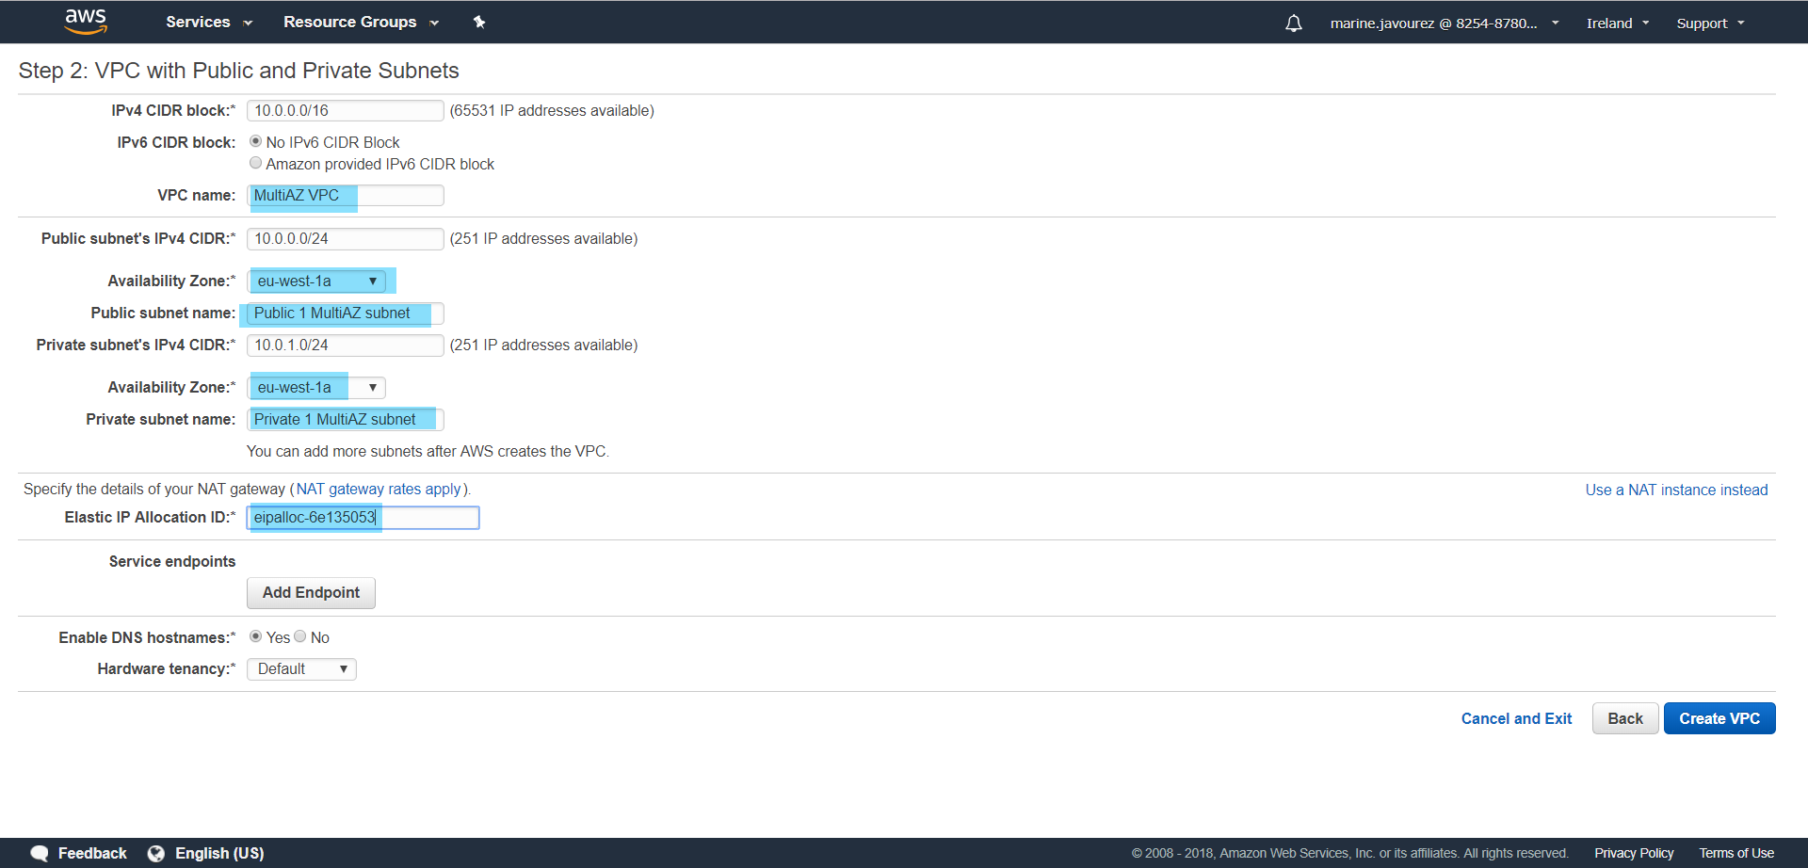
Select first AZ available
Select elastic IP previously created

Slide 5
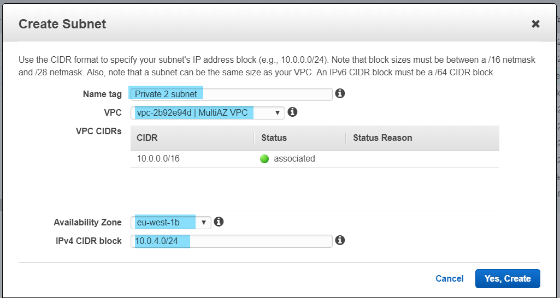
Create 2 other public and private subnet in the VPC :
Subnets
Create subnet
Do same for public subnet
Select the VPC created previously
Select the 2nd AZ available
Choose a CIDR range available

Slide 6
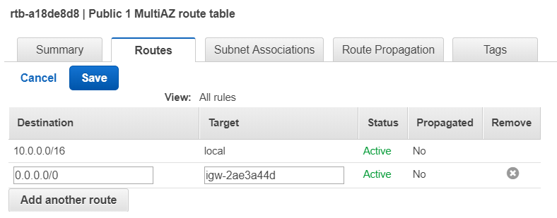
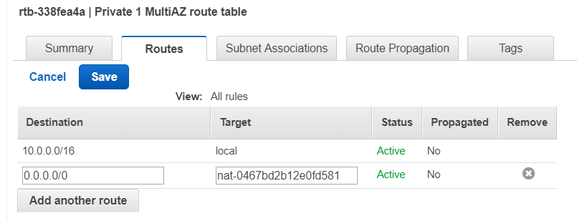
Set up route tables :
Route tables
2 routes tables have already created during VPC creation
Create 2 other route tables (one for each subnet)
Associate each route table to one subnet
For the public subnets :
For the private subnets :
Rely to internet gateway
Rely to NAT gateway

Slide 7
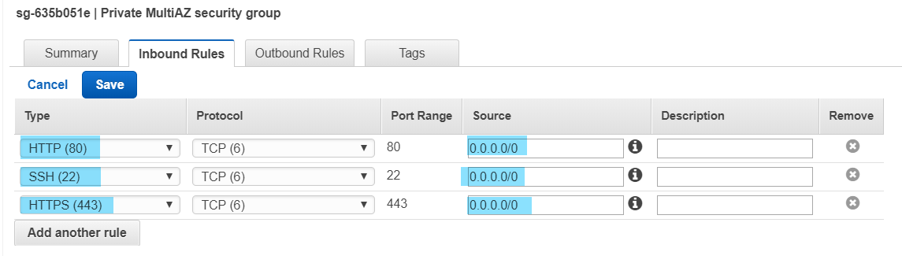
Configure security group :
Security Groups
Create 2 security groups (one for public, one for private) with rules below

Slide 8
Create webserver instances :
EC2
Launch instance
Select AMI
Next : Configure Instance Details

Slide 9
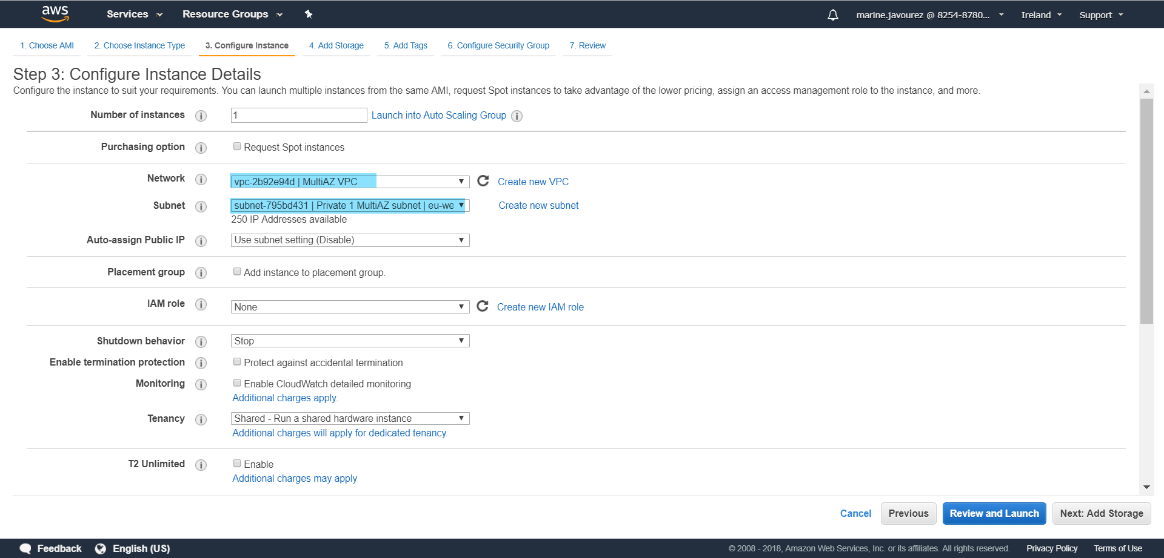
Choose VPC previously created
Choose private subnet

Slide 10
In advanced details :
Copy / Past :
#!/bin/bash
sudo yum update -y
sudo yum -y install httpd
sudo service httpd start
sudo bash -c 'echo Hello > /var/www/html/index.html’
Next : Add Storage, Next : Add tags
Next : Configure Security Groups
Select an existing group
Select private security group
Review and launch

Slide 11
Do same for 2nd private instance (change the text to display ex : « Bye bye » instead of « Hello »)
Create elastic load balancer :
Load Balancers
Create load balancer
Select Application Load Balancer

Slide 12
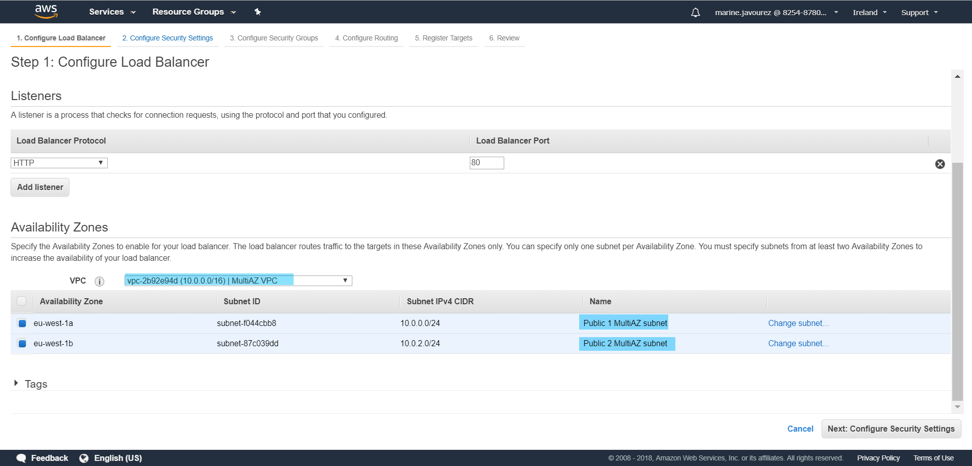
Select the VPC
Select both public subnet

Slide 13
Next : Configure Security Settings (A warning message may appear)
Next : Configure Security Groups
Select security group
Next : Configure Routing
Next : Register Targets

Slide 14
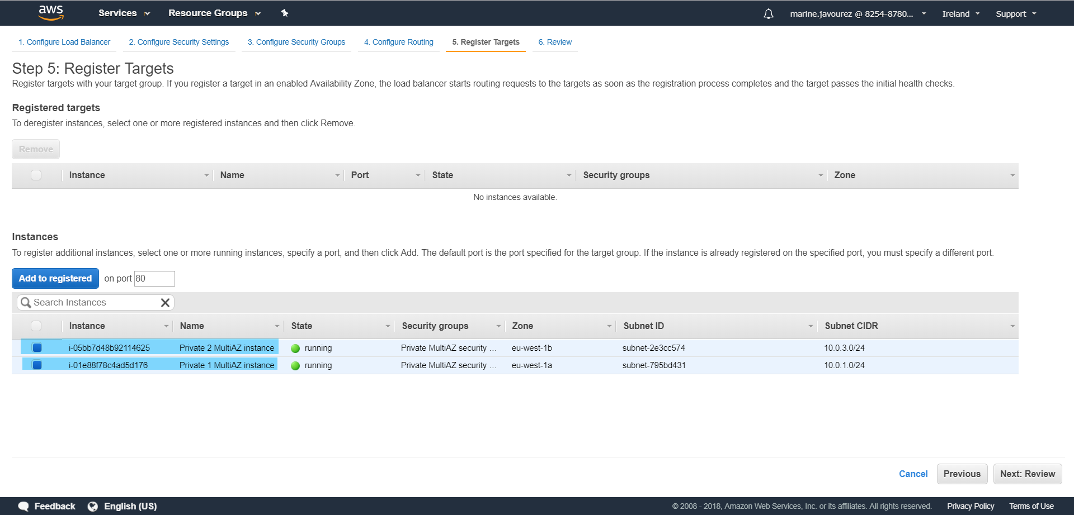
Select both webservers
Then click Add to registered

Slide 15
Do same for 2nd private instance (change the text to display ex : « Bye bye » instead of « Hello »)
Create elastic load balancer :
Next : Review
Create
Wait until the load balancer is active and copy / past DNS link in your browse
DONE! When your browse is refreshed, the text displayed changes

